Slide 1
Deep Learning and Image Analytics in Drug Discovery
Adam Corrigan, Quantitative Biology, Discovery Sciences, AstraZeneca
CCBI MPhil lecture

Slide 2
Outline
Image processing
Why do we use images in drug discovery/cellular screening?
Image classification
Transfer learning
Image Segmentation
U-net network

Slide 3
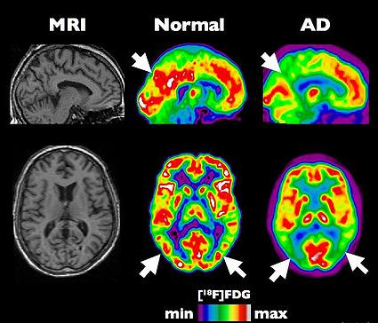
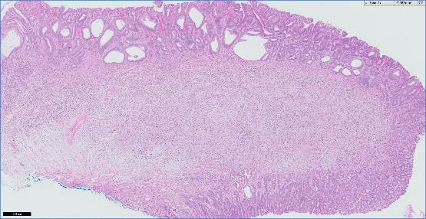
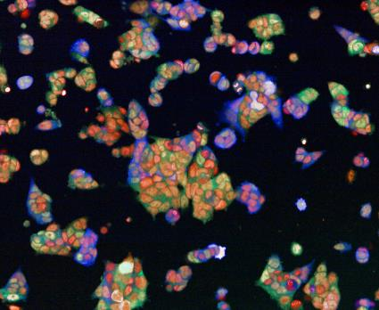
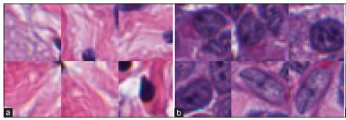
Imaging in Drug Development

Slide 4
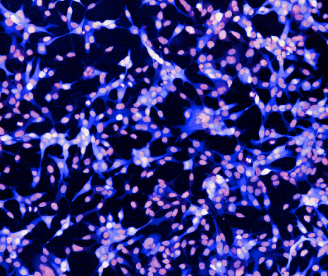
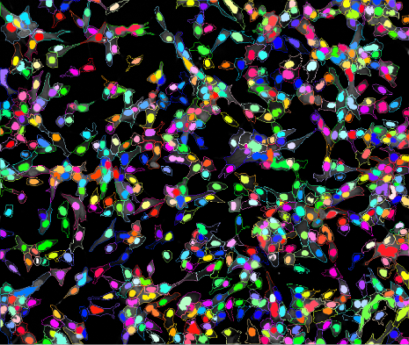
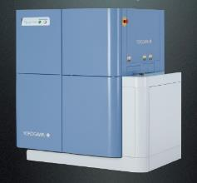
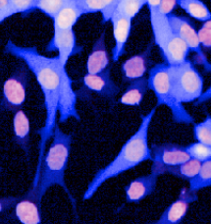
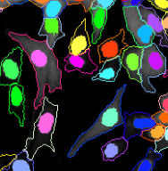
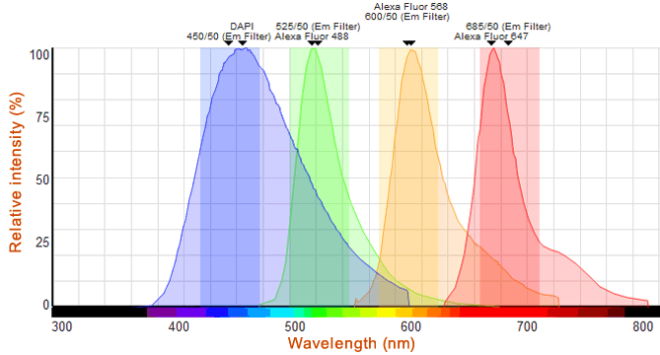
Fluorescence Microscopy and Analysis
High-throughput confocal microscope
Nuclear and Cell markers used as standard to robustly identify where and how many cells are in images
Uses 2 out of 4 colours available

Slide 5
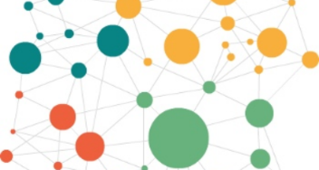
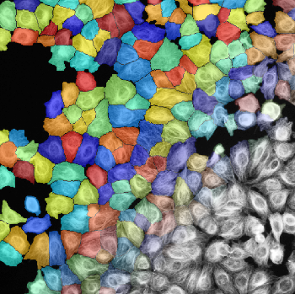
Hierarchy of AI Applications
Dataset annotation
Image features
Compound information
Cell line metadata
Learn to pick out high level correlations
Image Classification
Phenotypic screening
Artefact Detection
Translation prediction
Image Segmentation
Train machine to extract more information from fewer labels
Single cell phenotypes
Specific problem solving
Machine Intelligence

Slide 6
Challenges applying Deep Learning to BioImaging
Amount of training data
Augmentation eg rotation, flip
Unsupervised pretraining eg autoencoder
Transfer learning
Multi-task learning
Interpretability
Often need not just correct quantification, but to understand why

Slide 7
Image Classification using Transfer Learning

Slide 8
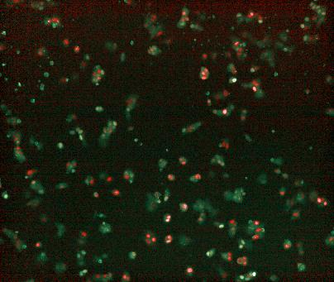
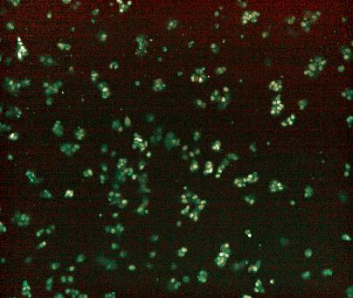
Imaging Screen – identify compounds which cause desired effect
Image phenotype is not always so clear- cut, especially at the start of development
Negative Control
Positive control – ‘hit’
Traditionally, assay development is iterative process:
Experimental methods Image Analysis
At each round, how do we know the image analysis is capturing the treatment effect?
Can deep learning be better and faster than us?

Slide 9
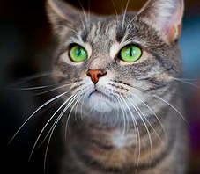
VGG16 architecture
[P(tench), P(goldfish),…,P(tabby),…]
138’357’544 parameters
1’200’000 training images
Conv2D+ReLU
MaxPool2D
Dense+ReLU
Softmax

Slide 10
Transfer Learning
Early layers of CNN encode low-level features
Very local, pixel neighbourhood
Later layers combine these into higher level abstract features
Larger scale objects
Final layers use high level features to perform classification
General nature of the low-level features means they are of use in other tasks beyond what they have been trained on

Slide 11
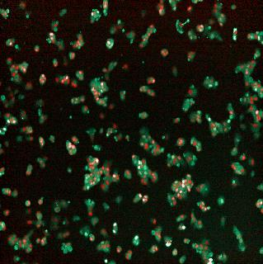
Transfer Learning
[P(tench), P(goldfish),…,P(tabby),…]
Conv2D+ReLU
MaxPool2D
Dense+ReLU
Softmax

Slide 12
Transfer Learning
Remove final layers, which are specific to the trained classes
[4096x1x1 features]
Conv2D+ReLU
MaxPool2D
Dense+ReLU
Softmax

Slide 13
Transfer Learning
Add new untrained layers
[100x1x1 features]
P(+ve control)
[1x1 sigmoid]
Conv2D+ReLU
MaxPool2D
Dense+ReLU
Sigmoid

Slide 14
Transfer Learning
Freeze the pretrained layers during training on new images
[100x1x1 features]
P(+ve control)
[1x1 sigmoid]
Conv2D+ReLU
MaxPool2D
Dense+ReLU
Sigmoid

Slide 15
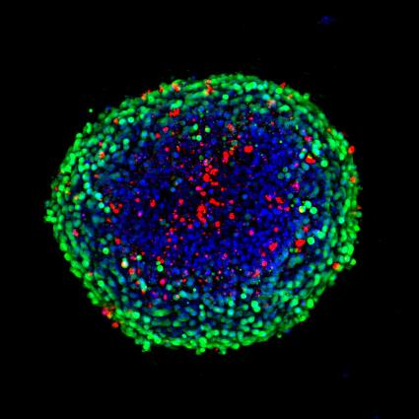

Handling Different Image Sizes
VGG16 takes RGB images of size 224x224. Microscopy images tend to be larger in size. Options:
Resize the images
Large-scale information (eg spheroid), downscale OK

Slide 16
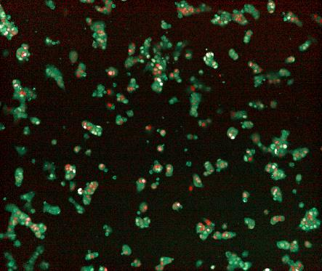
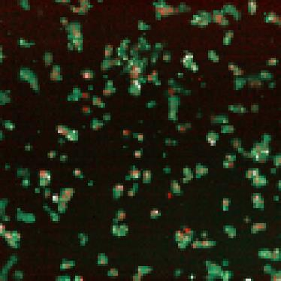
Handling Different Image Sizes
VGG16 takes RGB images of size 224x224. Microscopy images tend to be larger in size. Options:
Resize the images
Loss of cellular detail

Slide 17
Handling Different Image Sizes
VGG16 takes RGB images of size 224x224. Microscopy images tend to be larger in size. Options:
Resize the images
Transfer only the fully convolutional layers, train new dense layers
New dense layers after fully convolutional layers
Drawback – large number of parameters need training in this layer

Slide 18
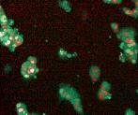
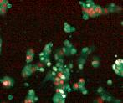
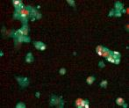
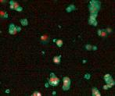
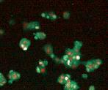
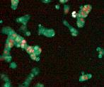
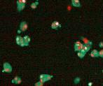
Handling Different Image Sizes
VGG16 takes RGB images of size 224x224. Microscopy images tend to be larger in size. Options:
Resize the images
Transfer only the fully convolutional layers, train new dense layers
Use image tiles
Prediction for each tile
Or merge features from all tiles and make single prediction

Slide 19
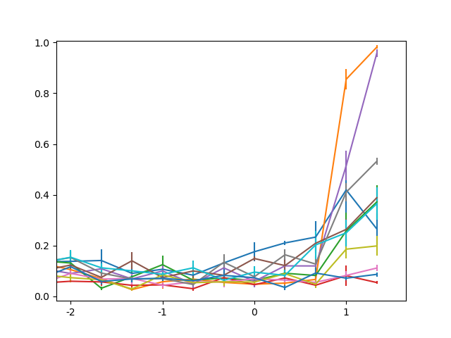
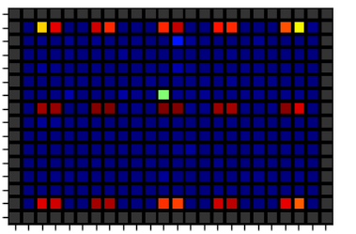
Application to Cellular Screening
P(Positive Control)
Identify hit compounds and retest over a range of concentrations
Log([Conc])
Dose response curves measure compound activity

Slide 20
Image Segmentation

Slide 21
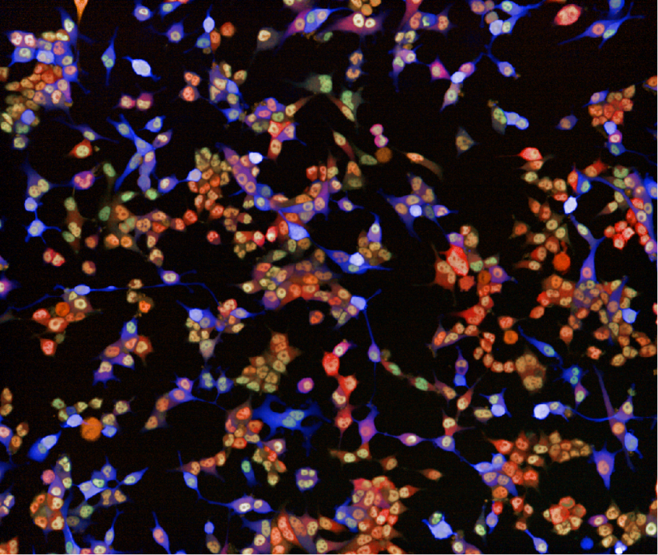
Single Cell Analysis
Cellular images have lots of detail:
Cell behaviours
Cell types
Local environment

Slide 22
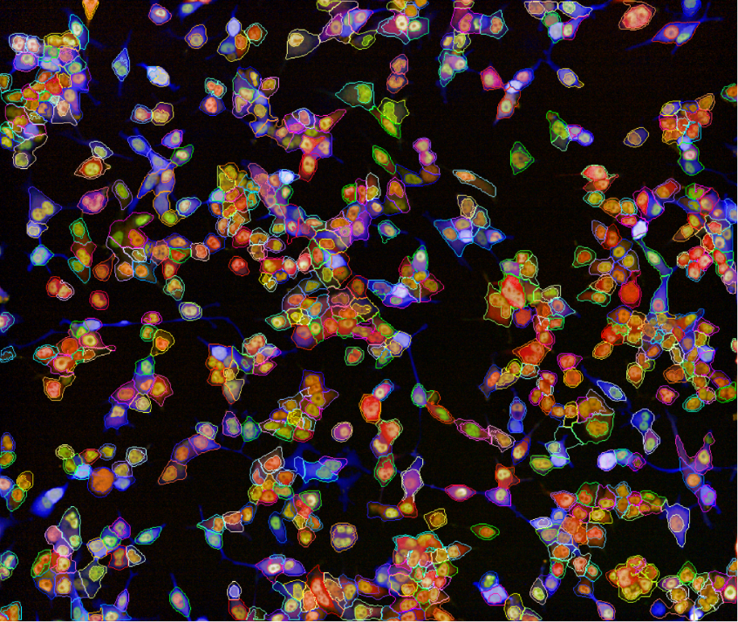
Single Cell Analysis
Cellular images have lots of detail:
Cell behaviours
Cell types
Local environment
Need to identify and segment cells to quantify rich information

Slide 23
Single Cell Analysis
Cellular images have lots of detail:
Cell behaviours
Cell types
Local environment
Need to identify and segment cells to quantify rich information
But don’t want to have to use a fluorescent marker for the nucleus and cytoplasm:
Cost of reagents
Preparation time
Uses up colour channels

Slide 24
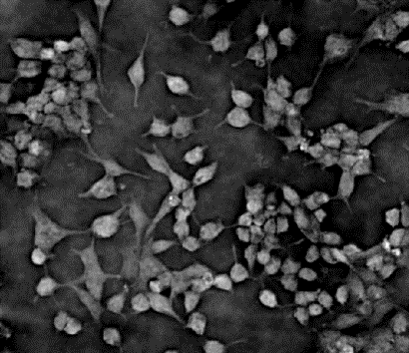
Single Cell Segmentation – Without Fluorescent Markers
Bright field image – no labelling
Very challenging to identify nuclei, even manually

Slide 25
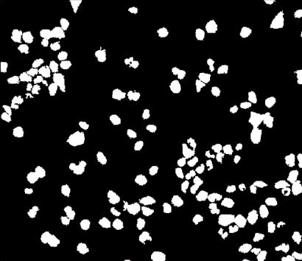
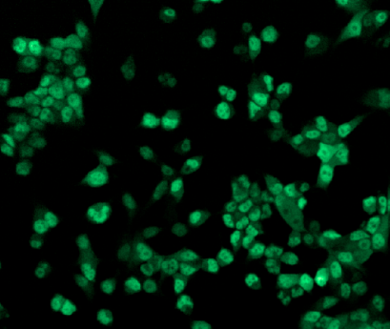
Single Cell Segmentation – Without Fluorescent Markers
Train neural network
Bright field image – no labelling
Very challenging to identify nuclei, even manually
Use fluorescent marker for training
Classical image analysis

Slide 26
Single Cell Segmentation – Without Fluorescent Markers
Train neural network
Bright field image – no labelling
Very challenging to identify nuclei, even manually
Use fluorescent marker for training
Then drop fluorescent marker once trained

Slide 27
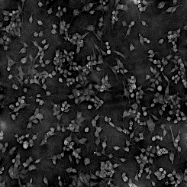
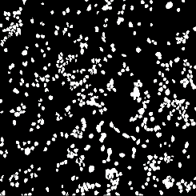
U-net architecture
Conv2D(3x3)+ReLU
MaxPool2D(2x2)
UpConv2D(2x2)+ReLU
Conv2D(1x1)+Sigmoid

Slide 28
Downscaling Block
Halving the spatial size while doubling the number of the filters
Same structure as standard CNN
Original U-net used valid padding which decreases the X-Y dimensions with each layer

Slide 29
Upscaling Block
Doubling the spatial size and halving the number of filters

Slide 30

Upscaling Block
Doubling the spatial size and halving the number of filters
Upscaling Convolution operation
Also referred to as Transposed Convolution, Deconvolution, or Fractionally Strided Convolution

Slide 31
Upscaling Block
Doubling the spatial size and halving the number of filters
Upscaling Convolution operation
Concatenate with output from downscaling branch
In original model, image dimensions are smaller in upscaling branch (valid padding), therefore crop downscaling branch image to the same size

Slide 32
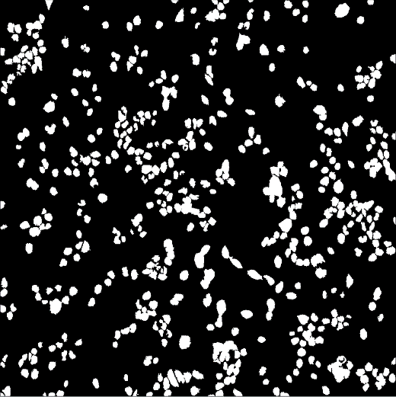
Final layers
Final layer is 1x1 convolution, reshapes into the number of outputs per pixel
As in other NN, final activation depends on application
Sigmoid for binary classification
Softmax for multiple classes
No activation for regression tasks – image to image

Slide 33
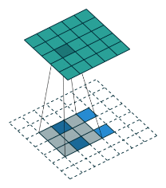
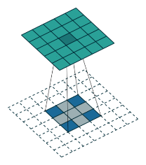
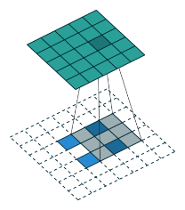
Modifications for Cellular Imaging
Original U-net was applied to regions of large images – valid padding
Cellular imaging – typically smaller images (1000x1000), but greater number (1000-10000)
Switch to same symmetric padding
No longer need cropping before concatenation
Fractionally strided convolution can introduce grid artefacts, especially using 3x3 filters
Replace fractionally strided convolution with Upscale layer followed by regular Convolution layer
4 | 2 | 4 | 2 | 4
2 | 1 | 2 | 1 | 2
4 | 2 | 4 | 2 | 4
2 | 1 | 2 | 1 | 2
4 | 2 | 4 | 2 | 4

Slide 34
U-net application

Slide 35
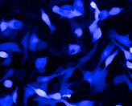
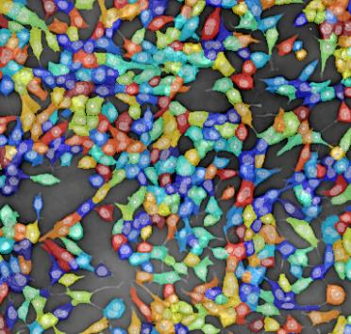
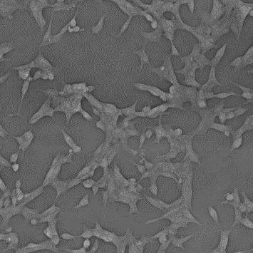
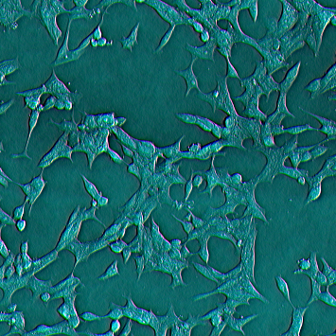
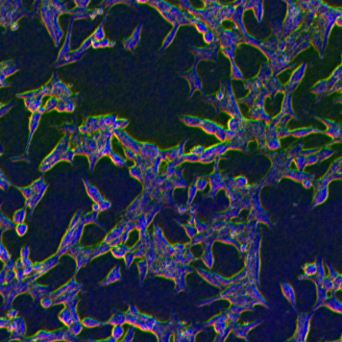
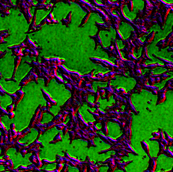
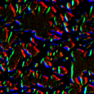
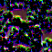
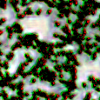
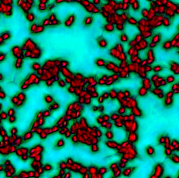
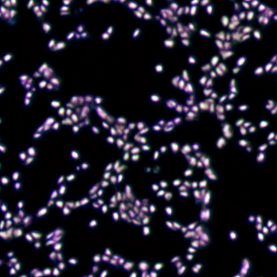





Label-free Semantic Segmentation for Assay Multiplexing – more biology at lower cost
The problem: Using nuclear and cell markers limits colours available to investigate biology
Segmentation
U-net Deep Neural Network
Label-free phase contrast image
Subpopulations
Marker 1
Marker 4
FKBP5
Marker 2
Marker 3
Multiple endpoints
No nuclear stain
No cell marker

Slide 36





General image segmentation workflow
Training data can be:
Another modality (eg bright field from fluorescence)
Manual annotation of images

Slide 37








Cell Division Cycle – more information from fewer labels
Fluorescent DNA Stain
Label free measurement
G1
G2
G1
G2
Transfer learning – repurpose pretrained network to predict new output at single cell level

Slide 38







Digital Multiplexing
Predict panel of biomarkers directly from label-free images
Reduce cost of reagents and preparation time by >50%
Reserve microscope channels for more relevant biology
Live imaging without expensive cell engineering – new possibilities
DNA
Proliferation
Cell Type
Metabolism
Cell Death
Senescence
Etc..

Slide 39










Image to Image translation
Digital biomarkers
Adversarial Networks
Isola et al.,
CVPR’17
Prediction of PET from MRI
Wide range of real-world applications

Slide 40
Summary
Deep learning is revolutionising the way image analytics is done
Not just about improving accuracy compared to humans, but enabling new types of experiment
Sufficient annotated training data is still a major challenge for bioimaging
CNNs learn general low-level features, which can be transferred to new tasks
U-net style networks perform image to image translation, maximising the amount of information that can be extracted from each image.

